Slide 1

Practice #3: PyTorch Basics Basic Concepts, Tensors, Data processing, Autograd mechanics, Feed-forward NN
[SKT AI Course: Deep Learning Basics]
TA: Jun-Sik Choi & Jee-Seok Yoon
Instructor: Heung-Il Suk
hisuk@korea.ac.kr
http://www.ku-milab.org
Department of Brain and Cognitive Engineering,
Korea University
September 24, 2017

Slide 2
Contents
Basic Concepts (Pytorch Vs. Tensorflow)
Pytorch Tensors
Autograd Mechanics
Data Loading and processing
Implement Feed-Forward Neural Network with Pytorch

Slide 3
PyTorch vs. Tensorflow

Slide 4
What is PyTorch?
PyTorch
Python based deep learning library for researching and developing deep learning models
Origin from lua-based deep learning library, Torch
Written by native python language (Not a simple set of wrapper to support Python)
Actively used at Facebook
Essentially a GPU enabled version for NumPy with higher-level functionality for building and training deep neural networks

Slide 5
What is Tensorflow?
Tensorflow
Deep learning library for researching, developing, and distributing deep learning models
Developed by Google Brain and actively used at Google
Programming language embedded within Python (Tensorflow codes are complied into a graph by Python and then run by the Tensorflow execution engine)

Slide 6
Differences - Adoption
Tensorflow
Well documented
Large user pool
Many tutorials are available
Hundreds of implemented and trained models on github
PyTorch
Quickly getting its momentum
Still in beta version (v. 0.2.0)
Nice documentation
Official tutorials
Several computer vision architectures available

Slide 7
Differences – Graph definition
They are different in a way to define directed acyclic graph (DAG)
Tensorflow
Use Static graph (Graph is defined before a model can run.)
All communication is performed via tf.session and tf.Placeholder
Support limited dynamic inputs
PyTorch
Use Dynamic graph (Graphs can be defined, changed, and executed as model runs).
Being tightly integrated with Python language, give more native and free way to work with models
Dynamic neural net like RNNs can benefit from this dynamic approach
Notes:
Both frameworks operate on tensors and view models as a directed acyclic graph(DAG)

Slide 8
Differences – Data loading
Tensorflow
Relatively not intuitive for data loading
Adding preprocessing code in parallel into Tensorflow graph is not straight-forward.
PyTorch
APIs for data loading are well designed.
A data loader takes a dataset and produces an iterator over the dataset.
Parallelizing data loading is simple.

Slide 9
Differences – Debugging
Tensorflow
Need to use a special debugging tool, tfdbg
tfdbg allows to evaluate tensorflow expressions at runtime and browse all tensors and operations in session scope
PyTorch
Graph is defined at runtime.
Can use your favorite Python debugging tools such as pdb, ipdb, Pycharm debuggers.

Slide 10
Differences – Visualization
Tensorflow
has its own visualization tool Tensorboard.
Tensorboard can
display model graph
plot scalar variables
visualize distributions and histograms
visualize images
visualize embeddings
play audio
PyTorch
Currently, no equivalent for Tensorboard.
Yet, Integrations to tensorboard do exist.
Standard plotting tools (matplotlib, seaborn) can be used.

Slide 11
Differences – Serialization
Both frameworks provides simple way to saving and loading models
Tensorflow
Tf.Saver object provides easy way to save models and check-points.
Entire graph can be saved as a protocol buffer.
Graph can be loaded in other supported languages (C++, JAVA)
PyTorch
Provides simple API that can save all the weights of a model

Slide 12
Difference – Custom extensions
Building or binding custom extensions written in C, C++ or CUDA is doable in both frameworks
Tensorflow
Requires more boilerplate code for custom extensions
PyTorch
Can make extensions by simply write an interface and corresponding implementation for each of the CPU and GPU versions

Slide 13
Differences – Deployment
Tensorflow
Tensorflow Serving provides a easy way to deploy models.
Models can be deployed into embeded system or mobile platforms.
Provides high performance server-side deployments
Supports Distributed training
PyTorch
For a small-scale server-side deployments are easy to wrap using Flask web server.
Supports Distributed training

Slide 14
Summary
Both frameworks provides useful abstractions to reduce repeated codes and speed up the model development.
PyTorch
Provides flexible dynamic graph definition
More 'pythonic' way for developing and debugging
An object-oriented approach
Better for rapid prototyping in research, and small scale projects.
Tensorflow
Provides great visualization and deployment tools.
A good choice when developing a model for production and deploying on mobile platforms
Better for large-scale deployments especially when cross-platform and embedded deployment is a consideration

Slide 15
PyTorch Tensor

Slide 16
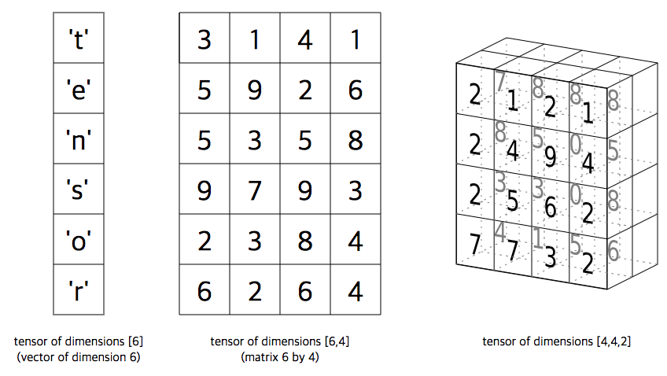
Tensor
torch.Tensor
A multi-dimensional matrix containing elements of a single data
Similar to numpy’s ndarray, except torch.Tensors can also be used on a GPU to accelerate computing.

Slide 17
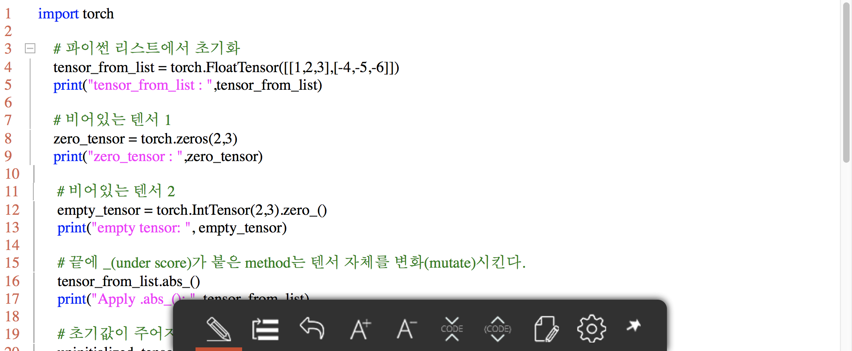
Create Tensor
Pytorch provides various ways to create Tensors (from list, ndarray,…)

Slide 18
Task #1
Uncomment examples_create_tensor(), run it, and observe the results
Refer to http://pytorch.org/docs/master/torch.html?highlight=tensor#creation-ops and Create Torch.Tensor in various way by yourself.
Check the GPU is available by torch.cuda.is_available() and if available, move tensors to GPU by .cuda() method.

Slide 19
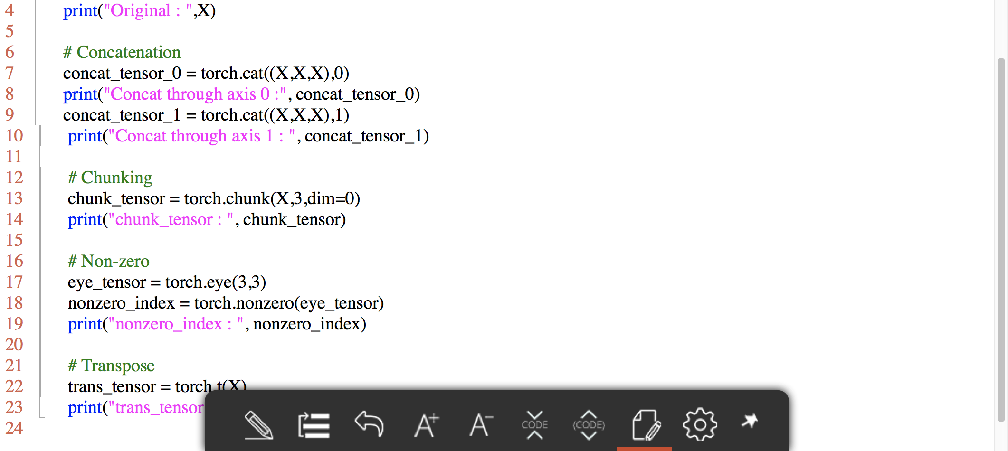
Manipulate Tensor

Slide 20
Task #2
Uncomment examples_manipulate_tensor(), run it, and observe the results
Refer to http://pytorch.org/docs/master/torch.html?highlight=tensor#indexing-slicing-joining-mutating-ops and manipulate Torch.Tensor in various way by yourself.

Slide 21
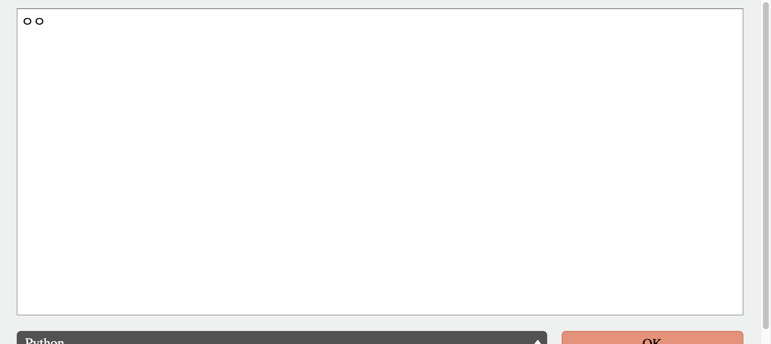
Tensor operation

Slide 22
Task #3
Uncomment examples_operate_tensor(), run it, and observe the results
Refer to http://pytorch.org/docs/master/torch.html?highlight=tensor#math-operations and test various Torch.Tensor operations in various way by yourself.

Slide 23
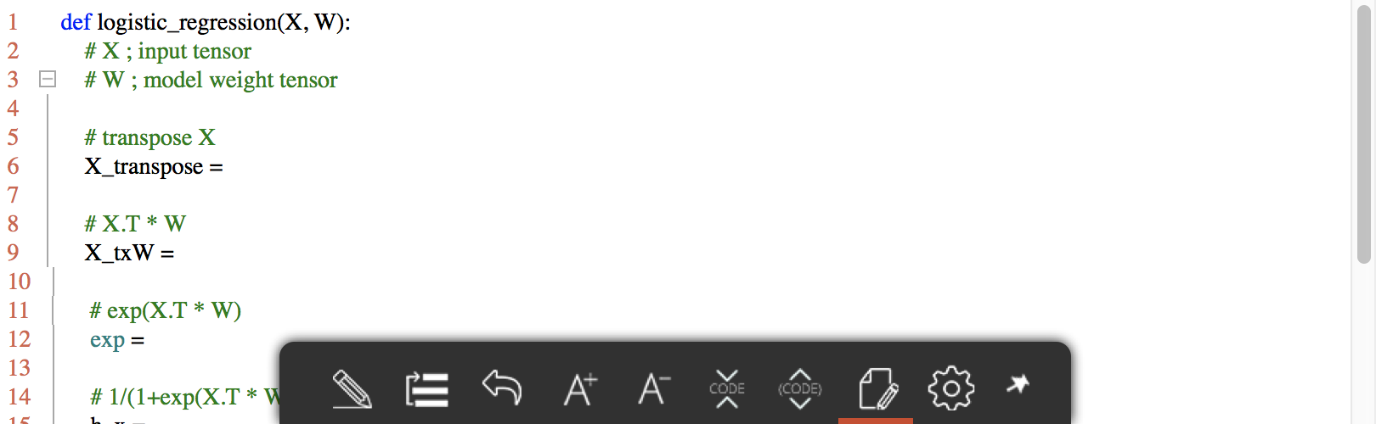
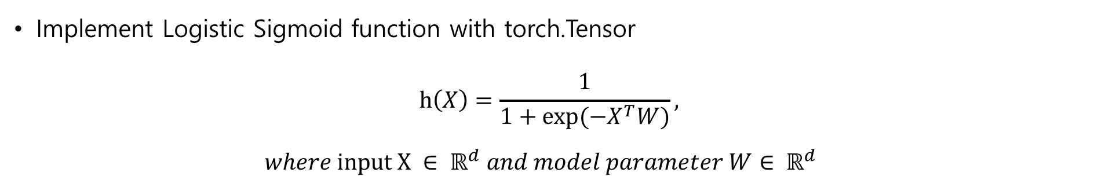
Quiz #1
Implement Logistic Sigmoid function with torch.Tensor $h\left(X\right)=\frac{1}{1+exp⁡(−X^{T}W)},$ $where input X ∈ ℝ^{d} and model parameter W∈ ℝ^{d}$

Slide 24
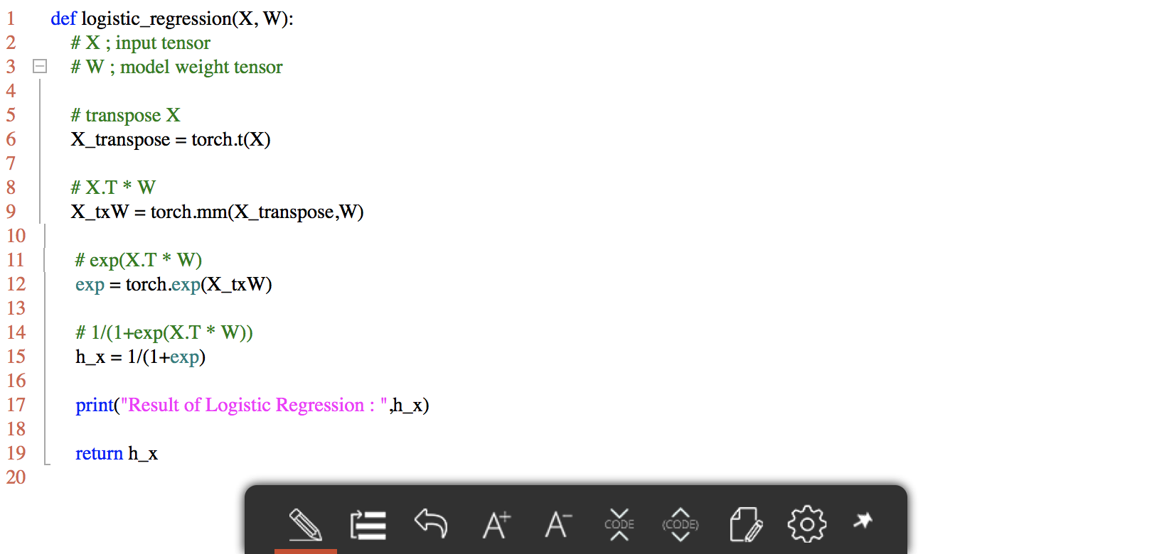
Answer

Slide 25
PyTorch Autograd mechanics

Slide 26
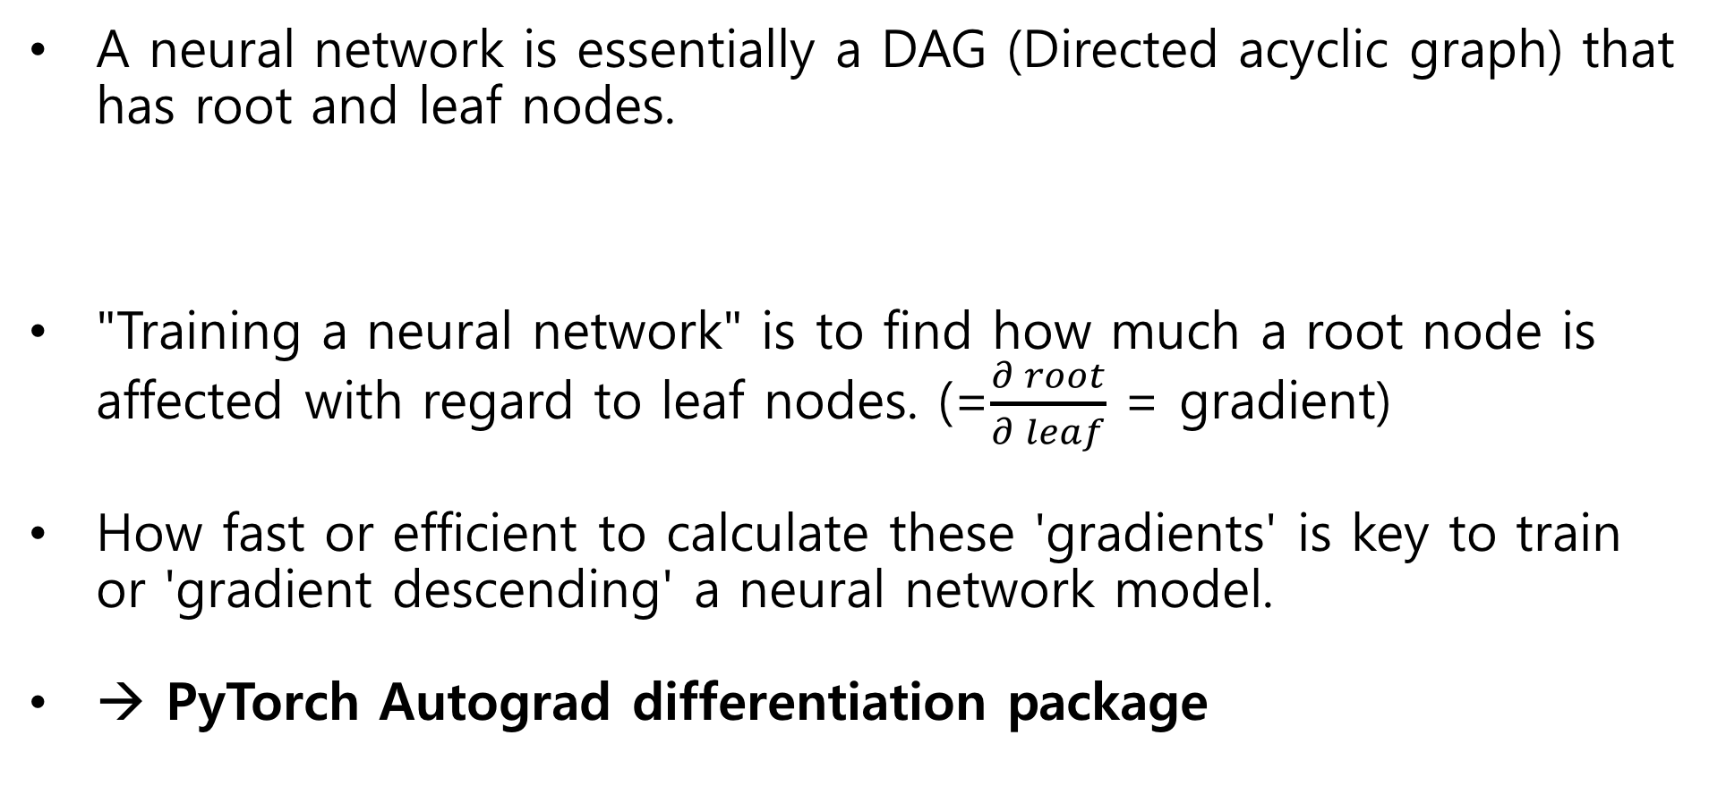
Automatic differentiation package
A neural network is essentially a DAG (Directed acyclic graph) that has root and leaf nodes.
"Training a neural network" is to find how much a root node is affected with regard to leaf nodes. (=$\frac{∂ root}{∂ leaf}$ = gradient)
How fast or efficient to calculate these 'gradients' is key to train or 'gradient descending' a neural network model.
→ PyTorch Autograd differentiation package

Slide 27
Automatic differentiation package
Autograd package
A reverse automatic differentiation system
Records a graph recording all of the operations that created the data giving you a directed acyclic graph.
Provides classes and functions implementing automatic differentiation of arbitrary scalar valued functions → To apply autograd package to a torch.Tensor, All tensors need to be wrapped into autograd.Variable objects.

Slide 28
Automatic differentiation package
class torch.autograd.Variable
Wraps a tensor and records the operation applied to it
Supports nearly all of operations defined to the tensor
Can access the raw tensor through .data
Gradient w.r.t variable is accumulated into .grad
grad_fn references a autograd.Function that created the Variable
→ autograd.Variable + autograd.Function => acyclic graph

Slide 29
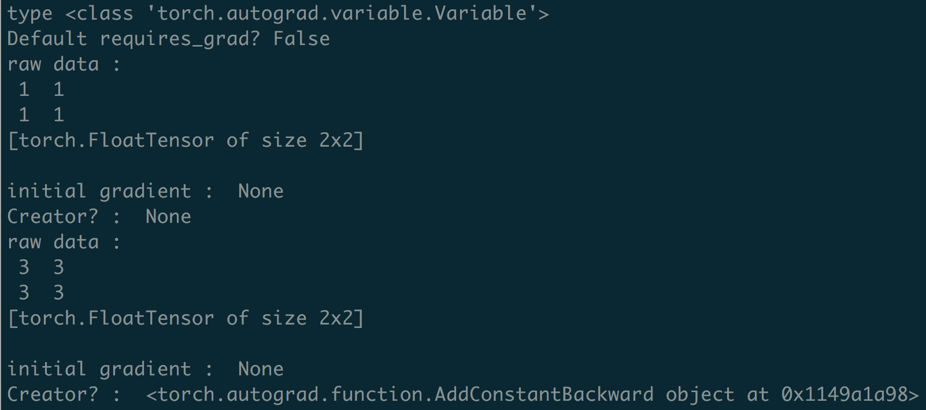
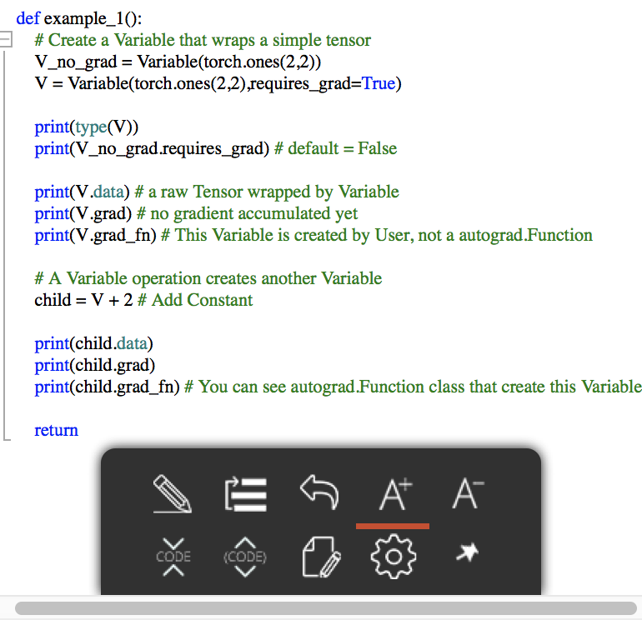
Example 1 : What is a autograd.Variable?

Slide 30
How to compute gradient?
torch.autograd.backward
Compute the sum of gradients of given variables w.r.t. graph leaves
Differentiated using the chain rule
Can call Variable.backward()
The leaf node's gradient is computed automatically.
Example 2 : Gradient computation toy example
B
*3
+
**2
mean
Out
A

Slide 31
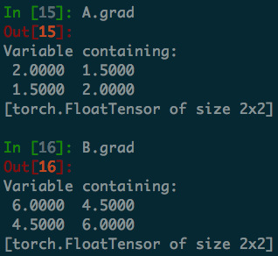
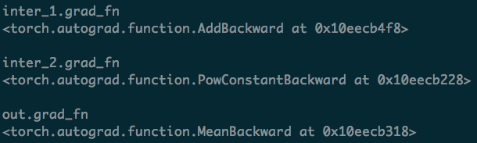
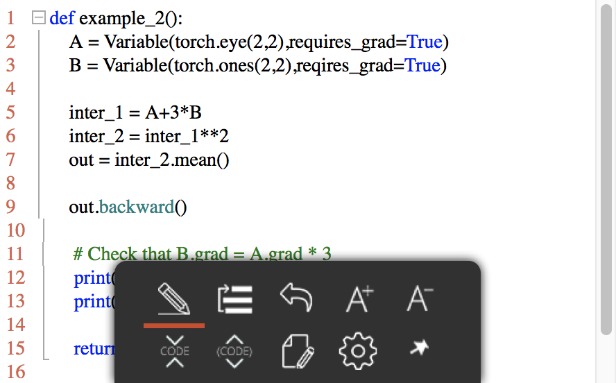
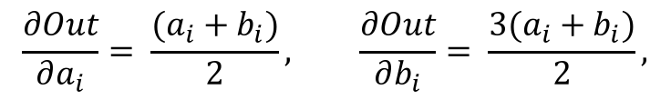
Example 2
$$\frac{∂Out}{∂a_{i}}= \frac{(a_{i}+b_{i})}{2}, \frac{∂Out}{∂b_{i}}= \frac{3(a_{i}+b_{i})}{2},$$

Slide 32
Excluding subgraphs from backward path
requires_grad
As you saw before, if input's requires_grad=True, the output of operation has requires_grad=True too, vice versa.
You can freeze part of your model with this property. (ex. finetuning model)
volatile
volatile is useful when you use a model as inference mode. (You won't be calling a .backward())
if a Variable has a flag "volatile=True", then requires_grad is also False.
Single volatile leaf → volatile output. (Yoy don't need to make every leaves have requires_grad=False)

Slide 33
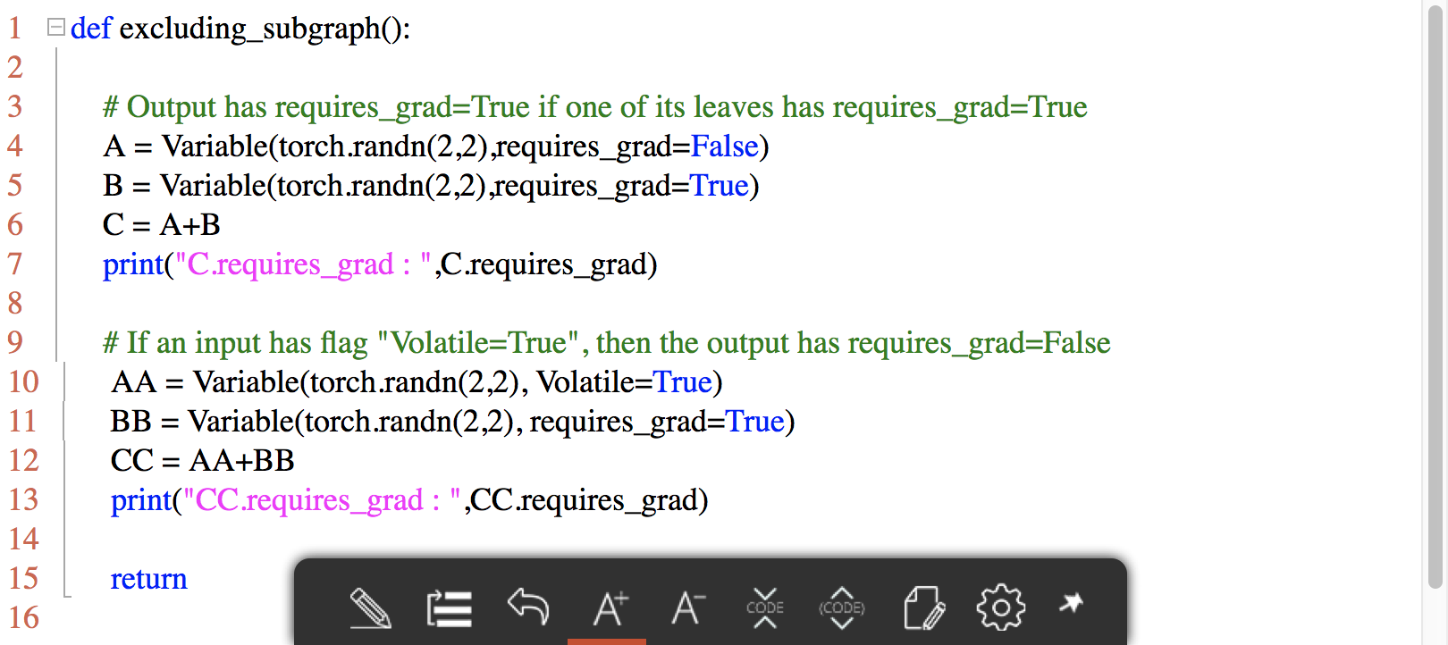
Volatile and requires_grad

Slide 34
Two-layer Neural Network Toy example

Slide 35
Data Loading and Processing

Slide 36
Data Loading and processing
Preparing the data for a model requires considerable time to solving any machine learning problems.
PyTorch provides many tools to make data loading easy
In this tutorial, we will see how to load and preprocess/augment data from a non-trivial dataset.

Slide 37
Class Dataset
torch.utils.data.Dataset
An abstract class representing a dataset
Custom dataset should inherit Dataset and override the following methods
__len__ : returns the size of the dataset.; len(dataset)
__getitem__ : support the indexing such that dataset[i] can be used to get ith sample.

Slide 38
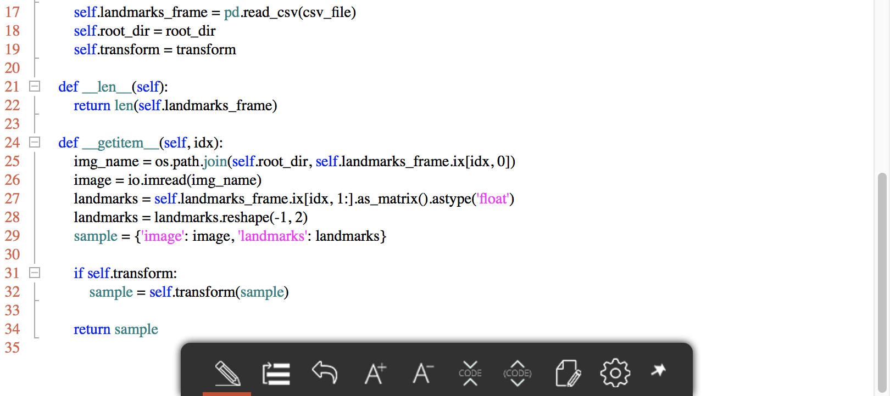
dataset.py

Slide 39
Transform
torchvision package consists of popular datasets, model architectures, and common image transformations for computer vision.
torchvision.transforms
provides common image transforms
transforms can be chained together using torchvision.transforms.Compose
Various torchvision transformations

Slide 40
Transform
Let’s create three transforms:
Rescale: to scale the image
RandomCrop: to crop from image randomly. This is data augmentation.
ToTensor: to convert the numpy images to torch images (we need to swap axes)
We will implement __call__() method so the transform need not be passed everytime it's called.

Slide 41
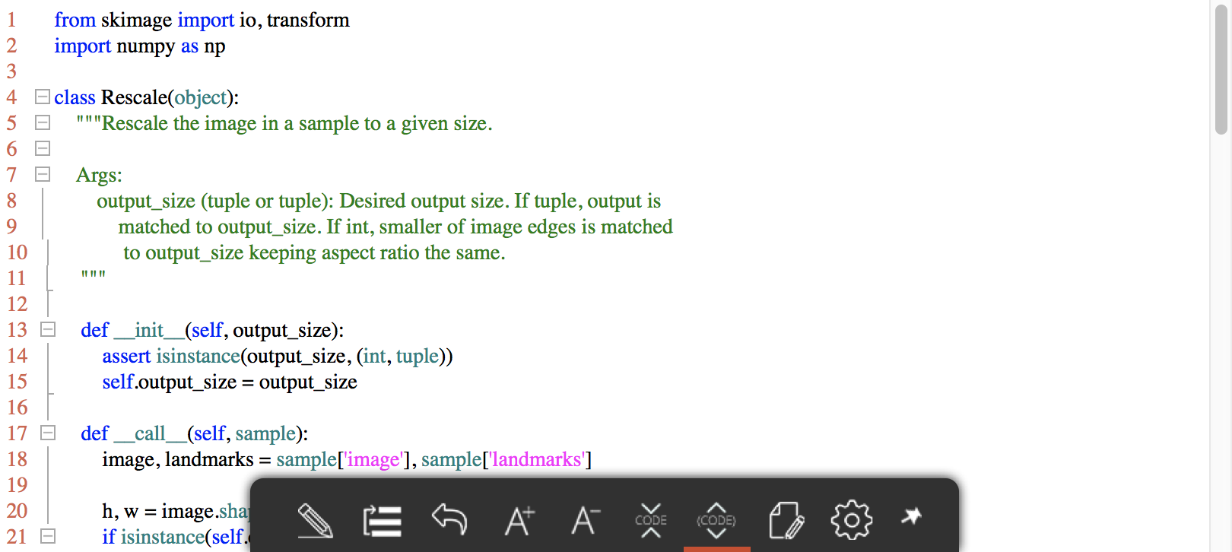
transforms.py

Slide 42
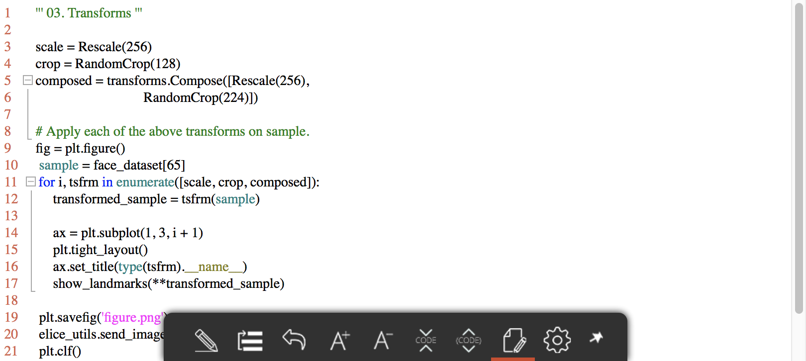
Apply transforms

Slide 43
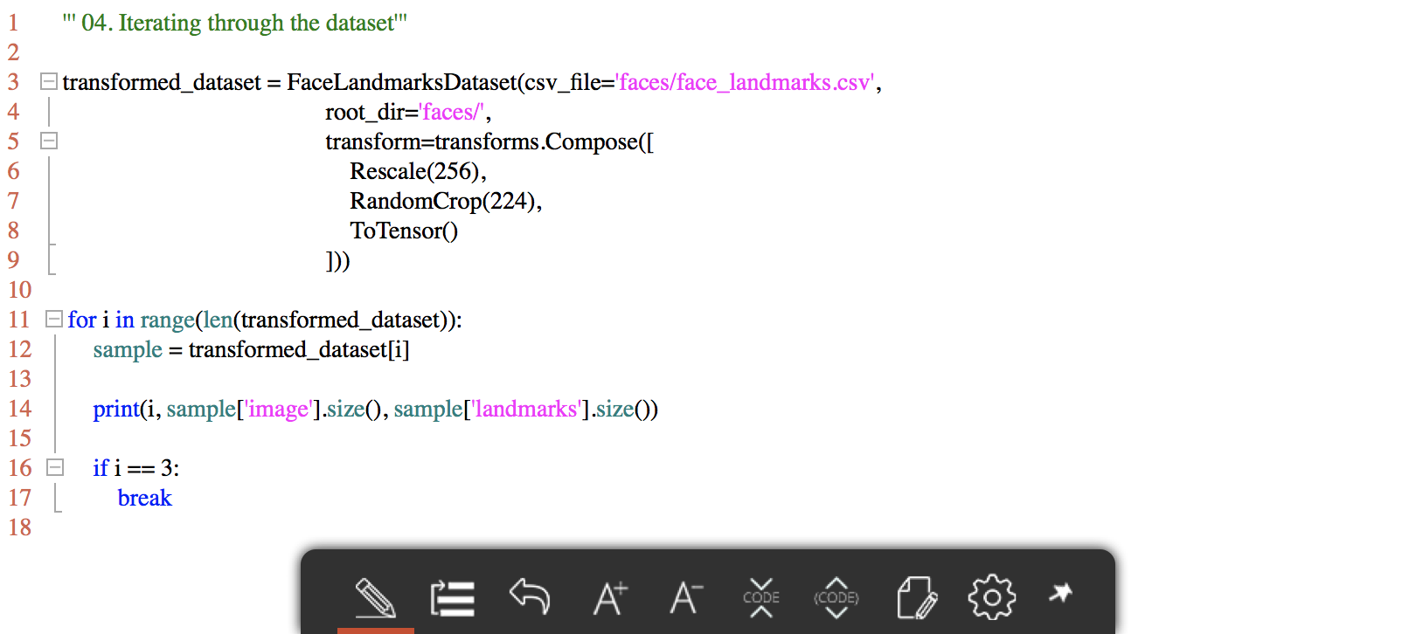
Iterate through dataset

Slide 44
Dataloader
Simple for loop can not make …
Batching the data
Shuffling the data
Load the data in parallel using multiprocessing workers
torch.utils.data.Dataloader
An Iterator.
Combines a dataset and a sampler, and provides single- or multi-process iterators over the dataset.

Slide 45
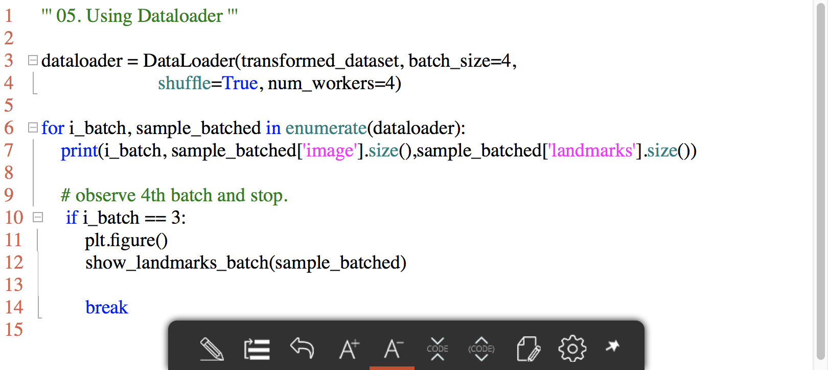
Using Dataloader

Slide 46
Summary & Afterword
we have seen how to write and use datasets, transforms and dataloader.
Torchvision package provides some common datasets and transforms.
You can use popular datasets (MNIST, COCO, LSUN, ImageNet-12, etc.) in torchvision.datasets
You can load images from folder using torchvision.datasets.ImageFolder

Slide 47
Implement Feed-Forward Neural Network with PyTorch

Slide 48
Neural Networks
Neural networks can be constructed using the torch.nn package.
An nn.Module contains layers, and a method forward(input) that returns the output → torch.nn modules
A typical training procedure for a neural network is as follows:
Define the neural network that has some learnable parameters (or weights)
Iterate over a dataset of inputs
Process input through the network
Compute the loss (how far is the output from being correct)
Propagate gradients back into the network’s parameters
Update the weights of the network, typically using a simple update rule: weight = weight - learning_rate * gradient

Slide 49
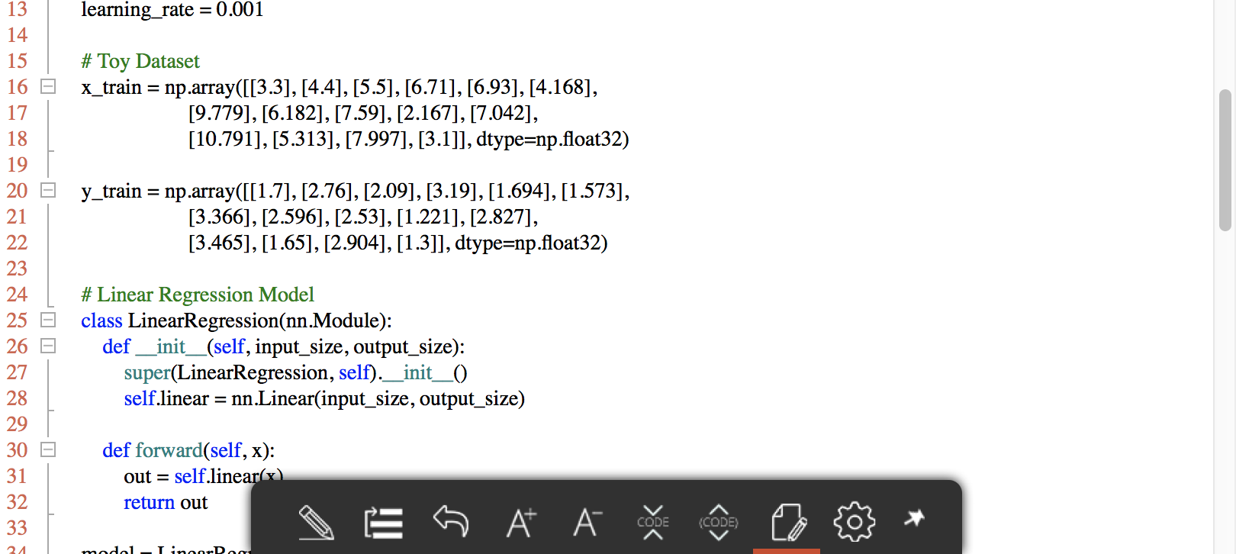
Linear Regression

Slide 50
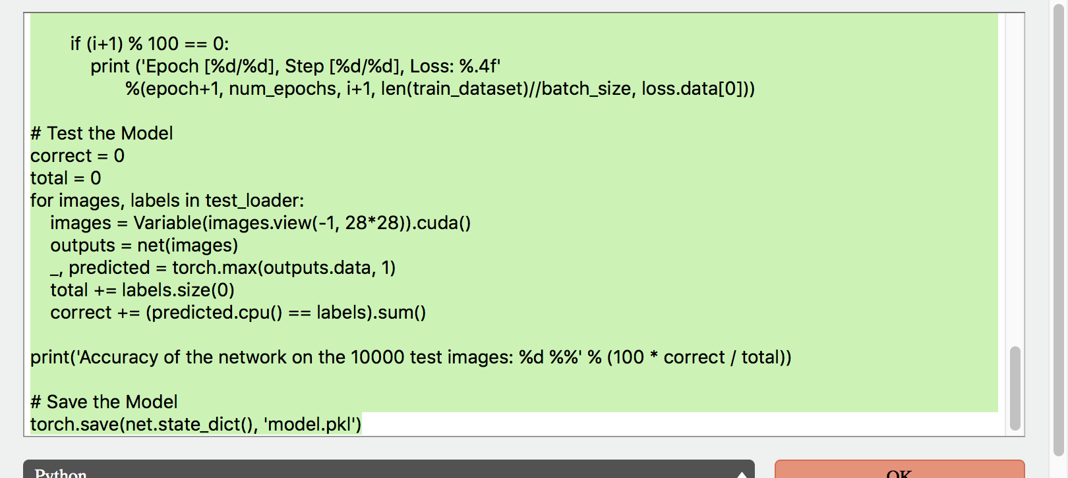
Feed Forward Neural Network (w/o optimizer)

Slide 51
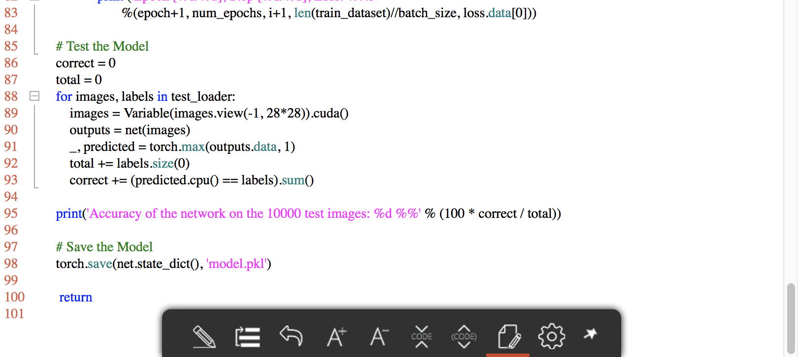
Feed Forward Neural Network (w/ optimizer)

Slide 52
Summary
we have seen how to define model, loss, optimizer, and train.
PyTorch provides various options to train and define neural networks.
More advance networks (CNN, RNN, GAN, … etc.) can be implemented in relatively readable and compact way in PyTorch

Slide 53
Reference
[1] https://medium.com/towards-data-science/pytorch-vs-tensorflow-spotting-the-difference-25c75777377b
[2] https://awni.github.io/pytorch-tensorflow/?imm_mid=0f5a8c&cmp=em-data-na-na-newsltr_ai_20170828
[3] https://github.com/yunjey/pytorch-tutorial
[4] https://chsasank.github.io/
[5] https://www.youtube.com/watch?v=nbJ-2G2GXL0&t=113s
[6] https://github.com/llSourcell/pytorch_in_5_minutes/blob/master/demo.py

Slide 54
Thank you
For your attention!!!
(Q & A)
hisuk (AT) korea.ac.kr
http://www.ku-milab.org

